Slide 1
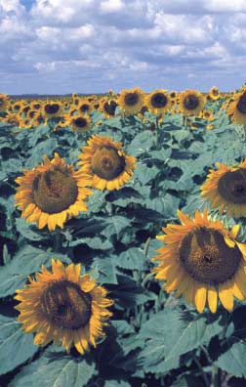
Quantum Photosynthesis

Slide 2
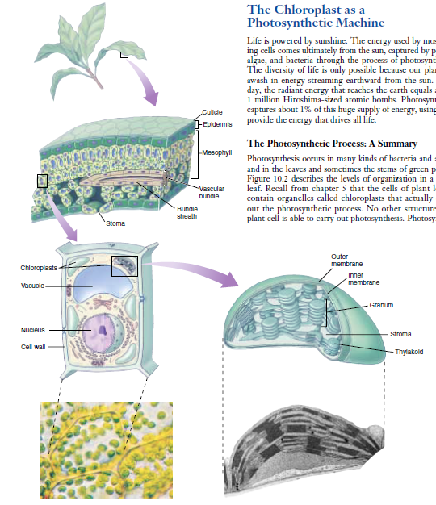
FIGURE 10.2
Journey into a leaf. A plant leaf possesses a thick layer of cells (the mesophyll) rich in chloroplasts. The flattened thylakoids in the
chloroplast are stacked into columns called grana (singular, granum). The light reactions take place on the thylakoid
Biology 6th ed. George Johnson, Peter Raven,.Mc Graw Hill

Slide 3
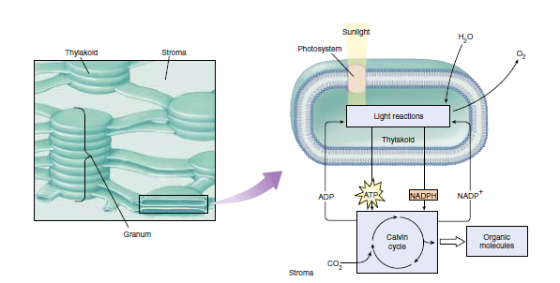
FIGURE 10.2 (continued)
membrane and generate the ATP and NADPH that fuel the Calvin cycle. The fluid interior matrix of a chloroplast, the stroma, contains the enzymes that carry out the Calvin cycle.
Biology 6th ed. George Johnson, Peter Raven,.Mc Graw Hill

Slide 4
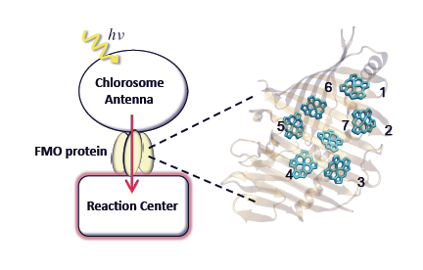
FIG. 1: The light harvesting apparatus of green sulfur bacteria and the Fenna-Matthews-Olson (FMO) protein. The schematic on the left illustrates the absorption of light by the chlorosome antenna and transport of the resulting excitation to the reaction center through the FMO protein. On the right is an image of a monomer of the FMO protein, showing also its orientation relative to the antenna and the reaction center [22, 24]. The multi-ring units are bacteriochlorophyll-a (BChla) molecules and the surrounding beta sheets and -helices form the protein environment in which the BChla molecules are embedded. The numbers label individual BChla molecules, also referred to as “sites" in the main text.
Quantum entanglement in photosynthetic light harvesting complexes
Mohan Sarovar, Akihito Ishizaki, Graham R. Fleming, and K. Birgitta Whaley

Slide 5
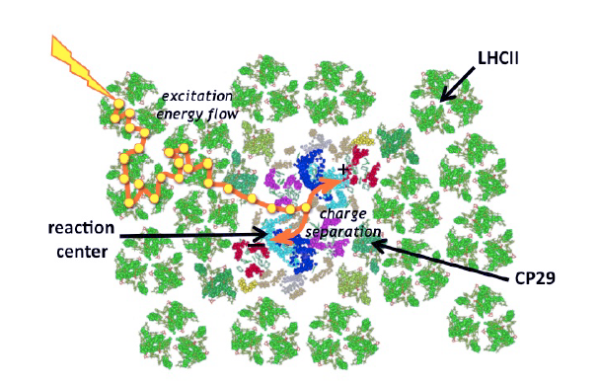
Fig. 1 The general architecture of the PSII supercomplex where antenna complexes
surround two reaction centers, exhibiting a symmetric architecture. Excitation energy
migrates from the antenna to the reaction center. A potential trajectory is shown above.
Design Principles of Photosynthetic Light-Harvesting
Graham R. Fleming, Gabriela S. Schlau-Cohena, Kapil Amarnatha, Julia Zaks

Slide 6
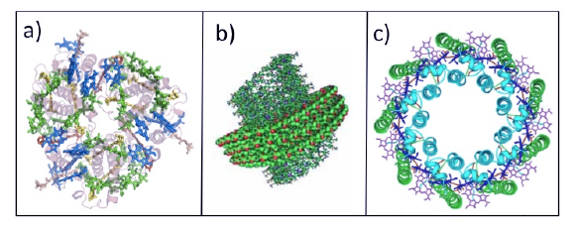
Fig. 2 Structural models of three photosynthetic antenna complexes: a) LHCII from higher plants; b) the chlorosome from green sulfur bacteria ; c) LH2 from purple bacteria.
Design Principles of Photosynthetic Light-Harvesting
Graham R. Fleming, Gabriela S. Schlau-Cohena, Kapil Amarnatha, Julia Zaks

Slide 7
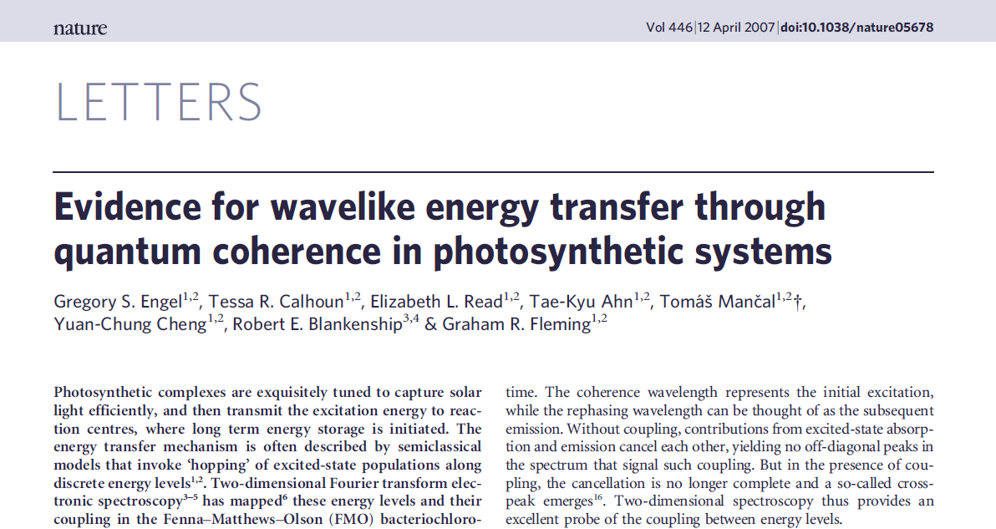

Slide 8
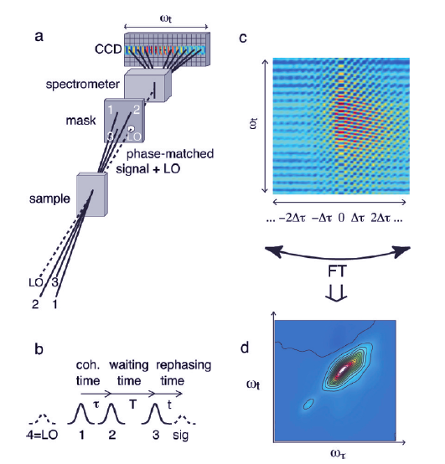
FIGURE 1. 2D spectra are constructed from the output signals of repeated three-pulse sequences. (a) Four light pulses impinge on a sample in a box geometry. Pulses 1, 2, and 3 generate the signal, which is heterodyne-detected with the weaker, copropagating local oscillator (LO). The signal and LO are dispersed at a grating onto a CCD. (b) Variable time delays between light pulses. The coherence time, τ, is swept from negative to positive values in order to generate a full 2D spectrum. Dynamics are observed during the waiting time T. The delay between pulse 3 and the output signal is referred to as the rephasing time. To assemble a 2D spectrum for a specific T, the detected signals for a set of coherence times spaced by Δτ are stacked (c) and are Fourier transformed (d).
Two-Dimensional Electronic Spectroscopy of Molecular Aggregates
NAOMI S. GINSBERG, YUAN-CHUNG CHENG, AND GRAHAM R. FLEMING

Slide 9
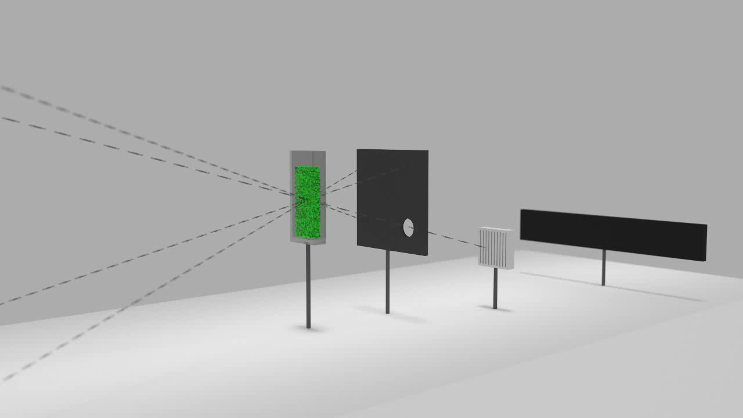
https://www.youtube.com/watch?v=45KJdVo_8C4
http://www.nat.vu.nl/en/research/biophysics/index.aspx

Slide 10
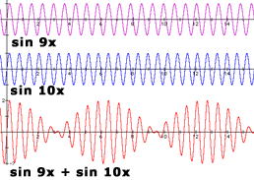
http://www.indiana.edu/~emusic/acoustics/phase.htm

Slide 11

https://www.youtube.com/watch?v=YTj4Hi1HdJQ
http://www.quantummadesimple.com

Slide 12
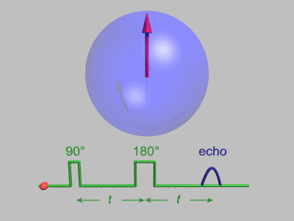
http://commons.wikimedia.org/wiki/File:GWM_HahnEchoDecay.gif

Slide 13

http://commons.wikimedia.org/wiki/File:GWM_SpinEcho2.gif

Slide 14
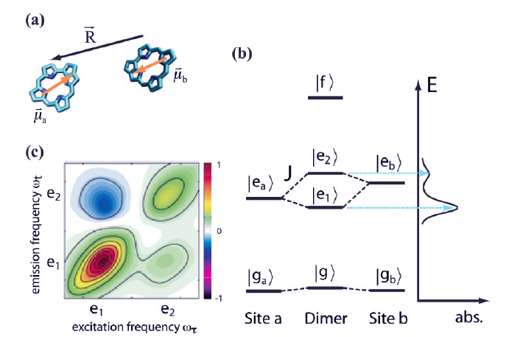
FIGURE 2. A coupled dimer of chlorophyll pigments: (a) chromophores are approximated as two-level electronic systems; (b) excitons e1 and e2 are superpositions of original states ea and eb, and are split due to coupling J, while f corresponds to two quanta of excitation. The
coupling also redistributes transition strength, shown in the absorption spectrum at right and also in the dimer 2D spectrum at T = 0 (c).
Two-Dimensional Electronic Spectroscopy of Molecular Aggregates
NAOMI S. GINSBERG, YUAN-CHUNG CHENG, AND GRAHAM R. FLEMING

Slide 15
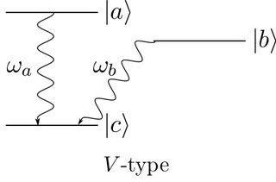
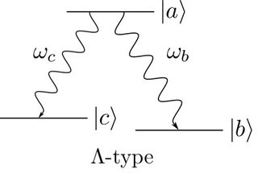
Quantum Beat
|ψ⟩=α|a⟩+β|b⟩
|ψ⟩⊗|0⟩a|0⟩b=(α|a⟩+β|b⟩)⊗|0⟩a|0⟩b
→α|c⟩⊗|1⟩a|0⟩b+β|c⟩⊗|0⟩a|1⟩b =|c⟩⊗(α|1⟩a|0⟩b+β|0⟩a|1⟩b)
|a⟩⊗|0⟩c|0⟩b
→γ|c⟩⊗|1⟩c|0⟩b+β|b⟩⊗|0⟩c|1⟩b
https://physics.stackexchange.com/questions/267845/intuition-for-why-there-are-quantum-beats-in-v-type-but-not-in-lambda-type

Slide 16
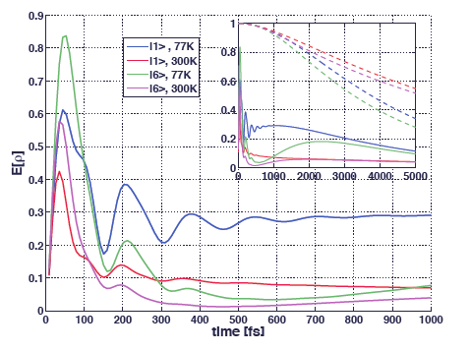
FIG. 2: Global entanglement in FMO. Time evolution of the global entanglement measure given in Eq. (2) for the two initial states |1> and |6>, at low (T = 77 K) and high (T = 300 K) temperatures. The inset shows the long-time evolution of the same quantities, together with the trace of the single excitation density matrix as dashed curves (identical color coding, and same units on axes as main figure).
Quantum entanglement in photosynthetic light harvesting complexes
Mohan Sarovar, Akihito Ishizaki, Graham R. Fleming, and K. Birgitta Whaley

Slide 17
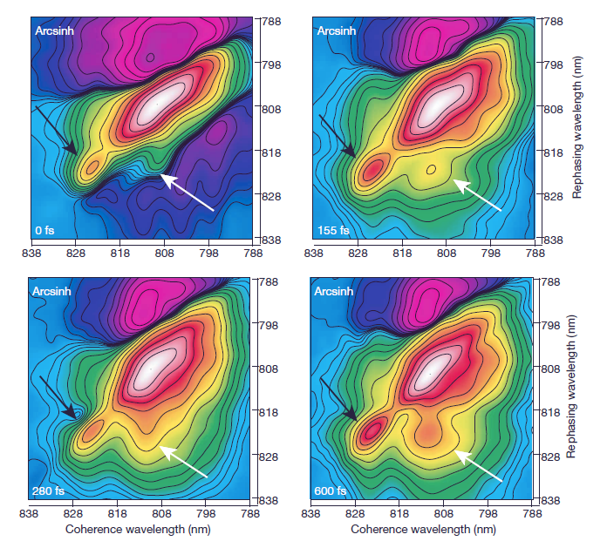
Figure 1 | Two-dimensional
electronic spectra of FMO. Selected two-dimensional electronic spectra of FMO are shown at population times from T50 to 600 fs
demonstrating the emergence of the exciton 1–3 cross-peak (white arrows), amplitude oscillation of the exciton 1 diagonal peak (black
arrows), the change in lowest energy exciton peak shape and the oscillation of the 1–3 cross-peak amplitude. The data are shown with an arcsinh coloration to highlight
smaller features: amplitude
increases from blue to white.
Evidence for wavelike energy transfer through quantum coherence in photosynthetic systems
Gregory S. Engel, Tessa R. Calhoun, Elizabeth L. Read, Tae-Kyu Ahn, Tomas Mancal, Yuan-Chung Cheng, Robert E. Blankenship & Graham R. Fleming

Slide 18
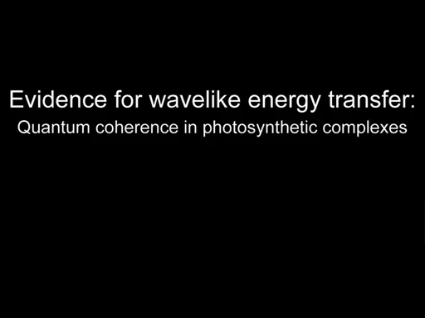
Evidence for wavelike energy transfer through quantum coherence in photosynthetic systems
Gregory S. Engel, Tessa R. Calhoun, Elizabeth L. Read, Tae-Kyu Ahn, Tomas Mancal, Yuan-Chung Cheng, Robert E. Blankenship & Graham R. Fleming

Slide 19
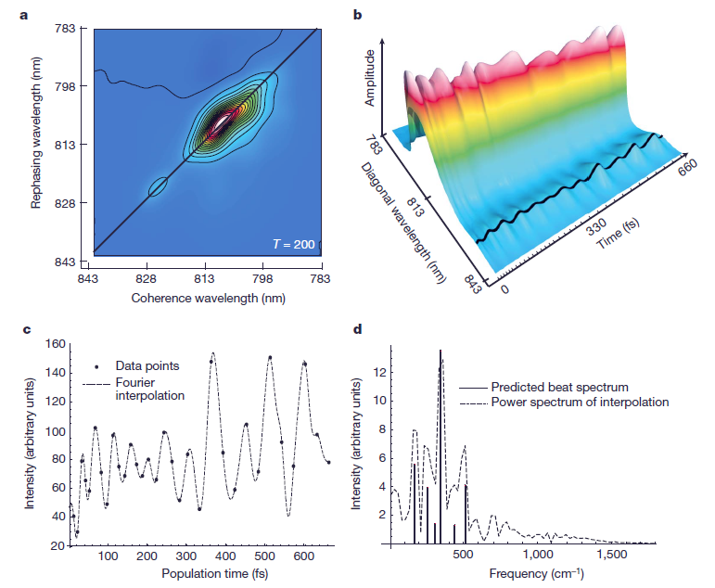
Figure 2 | Electronic coherence beating. a, A representative two dimensional electronic spectrum with a line across the main diagonal peak. The amplitude along this diagonal line is plotted against population time in b with a black line covering the exciton 1 peak amplitude; the data are scaled by a smooth function effectively normalizing the data without affecting oscillations. A spline
interpolation is used to connect the spectra; the times at which spectra
were taken are denoted by tick marks along the time axis. c, The amplitude of the peak corresponding to exciton 1 shown with a dotted Fourier interpolation. d, The power spectrum of the Fourier interpolation in c is plotted with the theoretical spectrum
showing beats between exciton 1 and excitons 2–7.
Evidence for wavelike energy transfer through quantum coherence in photosynthetic systems
Gregory S. Engel, Tessa R. Calhoun, Elizabeth L. Read, Tae-Kyu Ahn, Tomas Mancal,
Yuan-Chung Cheng, Robert E. Blankenship & Graham R. Fleming

Slide 20
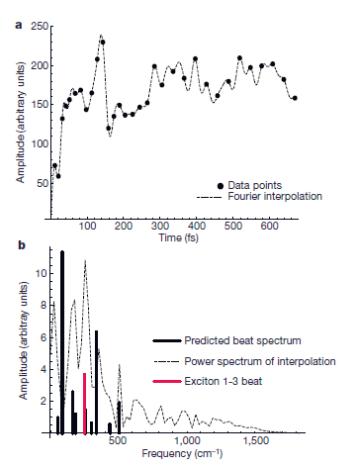
Figure 4 | Quantum beating in cross peaks. a, The raw amplitude of the exciton 1–3 cross-peak, with a Fourier interpolation of the points (dotted line). b, The power spectrum of this interpolation (dotted line), the exciton
beating line spectra of both excitons 1 and 3 (black), and the 1–3 beat frequency (red). We expect that the other frequencies may couple to this cross-peak but that the dominant frequency corresponds to the red transition. The apparent low-frequency peak is due to the growth of the cross-peak amplitude and appears as a peak because the data were demeaned (mean subtracted from the data) before the transform to improve numerical accuracy, pinning the zero-frequency component to zero.
Evidence for wavelike energy transfer through quantum coherence in photosynthetic systems
Gregory S. Engel, Tessa R. Calhoun, Elizabeth L. Read, Tae-Kyu Ahn, Tomas Mancal, Yuan-Chung Cheng, Robert E. Blankenship & Graham R. Fleming

Slide 21
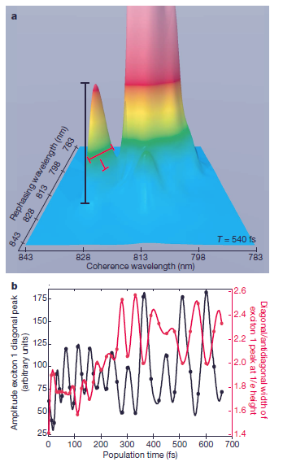
Figure 3 | Characteristic anticorrelation between peak amplitude and width. The anticorrelation shown in b between the amplitude of the diagonal exciton peak (black line in a) and the ratio of the diagonal to
anti-diagonal widths of the peak (red lines in a) is a characteristic predicted from theory for exciton quantum beating17. This pattern would not arise from phonon coupling and highlights the change in integrated line
strength associated with quantum beating.
Evidence for wavelike energy transfer through quantum coherence in photosynthetic systems
Gregory S. Engel, Tessa R. Calhoun, Elizabeth L. Read, Tae-Kyu Ahn, Tomas Mancal, Yuan-Chung Cheng, Robert E. Blankenship & Graham R. Fleming

Slide 22
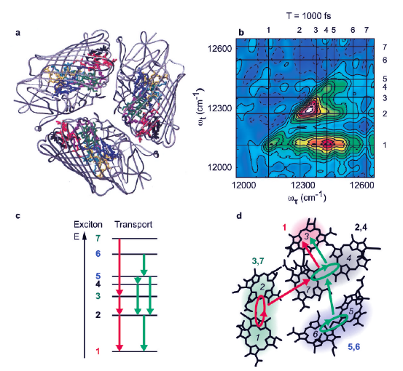
FIGURE 3. Two dimensional spectroscopy of FMO reveals energy transfer channels and explains why its structure efficiently promotes such transfer.23 (a) FMO crystal structure. Each of three monomers contains seven BChls. (b) T = 1 ps 2D spectrum of FMO complexes at 77 K with many clearly visible energy transfer peaks. Exciton energies are indicated on both axes. (c) Reconstruction of nonstepwise energy transfer channels based on 2D spectrum analysis. (d) Spatial map of energy flow from panel c in an FMO monomer.
Two-Dimensional Electronic Spectroscopy of Molecular Aggregates
NAOMI S. GINSBERG, YUAN-CHUNG CHENG, AND GRAHAM R. FLEMING

Slide 23
Method
Sample preparation. The FMO sample was isolated from Chlorbium tepidum as published previously. The sample was dissolved in a buffer of 800mM tris/HCl pH8.0, 50mM NaCl with 0.1% lauryldimethylamine oxide as a detergent. The sample was then mixed 65:35v/v in glycerol, placed in a 200mm quartz cell (Starna). The sample was cooled in a cryostat (Oxford Instruments) to 77K
Data acquisition. A home-built oscillator was used to seed a home-built regenerative amplifier to produce a 3.4kHz pulse train of 41fs pulses centered about 808nm with a spectral width of 31nm full-width at half-maximum (FWHM). The stability of the laser system through the data acquisition period was measured to be 0.28% to 0.44%. The laser pulse width was measured with both autocorrelation (38fs FWHM) and frequency resolved optical gating (FROG) (41fs FWHM).
NATURE|Vol 446|12 April 2007

Slide 24
Additional Resources
Quantum Mechanics of Photosynthetic Light Harvesting Machinery -https://www.youtube.com/watch?v=CnHM-PyN0gg
ICAM, the Institute for Complex Adaptive Matter is a global network of research institutions with an interest in emergent phenomena in quantum matter.
http://icam-i2cam.org/
Quantum Coherence & Entanglement in Photosynthetic Light-Harvesting Complexes - P. Nalbach - https://www.youtube.com/watch?v=lXS2hMkwtLI&list=PLdV51-1AzT3MrUTHTWc3OafFZuE7trz_-&index=2
Coherent Oscillations in 2D Photon-Echo Signals of Photosynthetic Complexes - D.Egorova - https://www.youtube.com/watch?v=1waHd7D8g40&list=PLdV51-1AzT3MrUTHTWc3OafFZuE7trz_-&index=11
Quantum Mechanics of Photosynthetic Light Harvesting - D. Coker -https://www.youtube.com/watch?v=yt10n_5doFk&list=PLdV51-1AzT3MrUTHTWc3OafFZuE7trz_-&index=7
Quantum-mechanical Optimization of Light-Harvesting in Photosynthesis - G. Scholes - https://www.youtube.com/watch?v=Nu-tDoCz2G8&list=PLdV51-1AzT3MrUTHTWc3OafFZuE7trz_-&index=5

Slide 25
Additional Resources
Evidence for wavelike energy transfer through quantum coherence in photosynthetic systems
Gregory S. Engel, Tessa R. Calhoun, Elizabeth L. Read, Tae-Kyu Ahn, Toma´sˇ Mancˇal, Yuan-Chung Cheng, Robert E. Blankenship & Graham R. Fleming
Vol 446| 12 April 2007| doi:10.1038/nature05678
Direct evidence of quantum transport in photosynthetic light-harvesting complexes
Gitt Panitchayangkoon, Dmitri V. Voronine, Darius Abramavicius, Justin R. Caram, Nicholas H. C. Lewis, Shaul Mukamel, and Gregory S. Engel
20908–20912 ∣ PNAS ∣ December 27, 2011 ∣ vol. 108 ∣ no. 52
Functional quantum biology in photosynthesis and magnetoreception
Neill Lambert, Yueh-Nan Chen, Yuan-Chung Cheng, Che-Ming Li, Guang-Yin Chen, Franco Noria
arXiv:1205.0883v1 [physics.bio-ph] 4 May 2012

